Slide 1
Lotka-Volterra competition
When can two competing species live together?
Notes:
Leave this up while students settle, then go straight to the next slide. The deck is reference only: no lecture. Students work from the online book; the slides show what they should see.
Photo: red flour beetle, *Tribolium castaneum*, one of Park's competing species (we meet them again at the end). If the picture placeholder is empty, drop in the photo listed in images/CREDITS.md.

Slide 2
Work through the Lotka-Volterra competition practical in the online book
2 SESSIONS · PAIRS
Session 1: Part 1 (build the model) and Part 2 (explore it)
Session 2: Part 3 (Q1 to Q4; Q5 optional)
Sketch and predict before you run
Check your work against the next slides
Notes:
Leave this slide up while students work. Everything they need is in the book chapter: the worksheet download, the formula for B12, the Part 2 prompts and the Part 3 questions.
Part 1 (about 15 min): type the species 1 formula in B12 (given), write species 2's in C12 (answer: =C11+$F$7*C11*($F$8-C11-$F$9*B11)/$F$8), copy to row 211. Common errors: missing $ signs, and dividing species 2's growth by K~1~.
Part 2 (about 15 min), answers: α = β = 0 gives (1200, 1000) and #DIV/0! in two isocline cells; species 1 is lost once α > K~1~/K~2~ = 1.2 (at α = 1 they coexist at (400, 800); at α = 1.3 species 1 is still about 5 after 50 steps); R~1~ = 0.2 still settles at (720, 640), only more slowly; intercepts 1200 and 2000 on the N~1~ axis, 1000 and 1600 on the N~2~ axis.
Part 3 (session 2): insist on the prediction before running, and on looking at all 200 time steps.

Slide 3
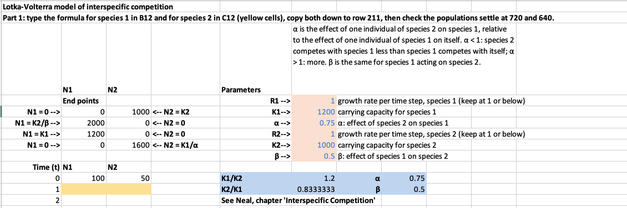
Your worksheet
Yellow: your formulas (B12, C12). Orange: the parameters you change. Blue: the invasion check (do not edit).
Notes:
Screenshot of the student worksheet as downloaded (Excel, Mac), rows 1-13. Show it with the task slide so students can find their way around: the two yellow cells are the only ones they type in for Part 1; in Parts 2 and 3 they change only the orange cells (and, for Q4 and Q5, the starting sizes in B11 and C11). The blue block puts K~1~/K~2~ next to α and K~2~/K~1~ next to β, so they can check the invasion rule directly.

Slide 4
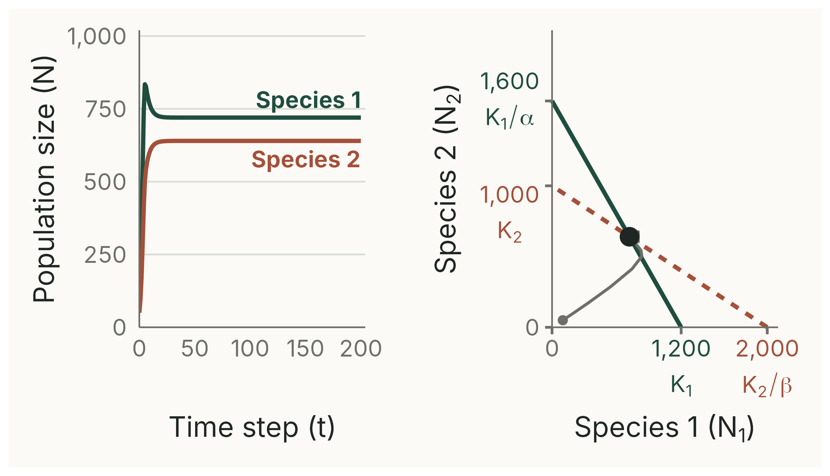
Check your sheet
CHECK
With the worksheet's starting values (R₁ = R₂ = 1, K₁ = 1200, α = 0.75, K₂ = 1000, β = 0.5, start 100 and 50), both species settle at N₁ = 720 and N₂ = 640.
Notes:
(2 min) If a sheet does not settle at (720, 640): check the $ signs in the formulas, and that each formula uses its own species' K in the denominator.
Equilibrium by hand: N~1~* = (K~1~ − αK~2~)/(1 − αβ) = (1200 − 750)/0.625 = 720; N~2~* = (K~2~ − βK~1~)/(1 − αβ) = (1000 − 600)/0.625 = 640.
Deterministic simulation of the worksheet model, script 02_check_sheet.R; numbers printed by 00_check_numbers.R.

Slide 5
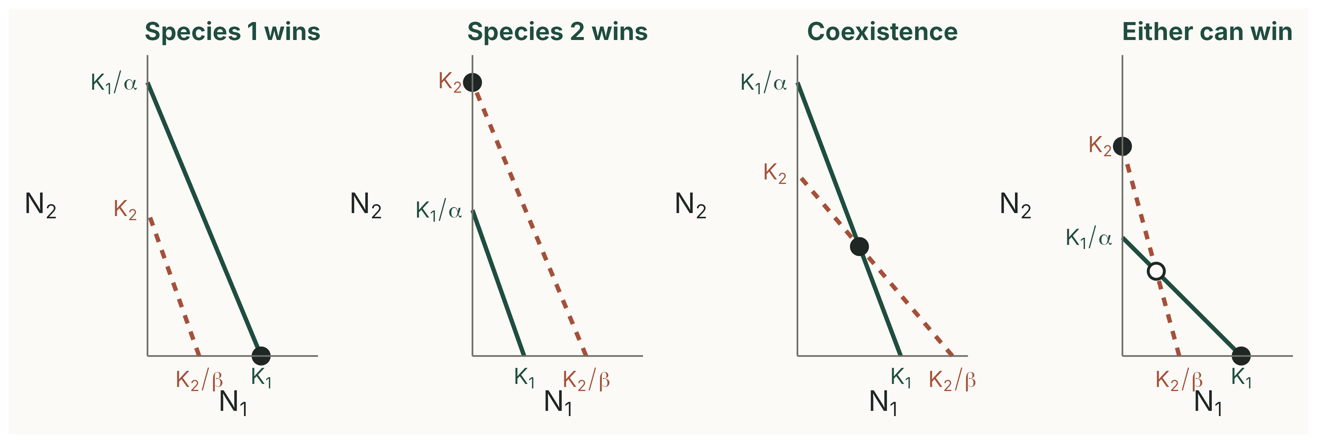
What your phase graph can show
Solid: species 1 (K₁, K₁/α). Dashed: species 2 (K₂, K₂/β). Filled circle: stable equilibrium. Open circle: unstable.
Notes:
Reference for Part 3 (put it up if pairs are stuck). Read each case by asking which line is further out on each axis.
1. Species 1's isocline is outside species 2's everywhere: K~1~ > K~2~/β and K~1~/α > K~2~. Species 1 wins.
2. The reverse: species 2 wins.
3. They cross, with K~1~ < K~2~/β and K~2~ < K~1~/α: stable coexistence where they cross.
4. They cross the other way: the crossing point is unstable, and whichever side the populations start on decides the winner.
Illustrative values, analytical schematic, script 03_four_outcomes.R.

Slide 6
Answers: try first
Notes:
Show at the end of session 2. The answers use the parameter values of the book's solutions chapter, so students reviewing the slides afterwards see the same numbers.

Slide 7
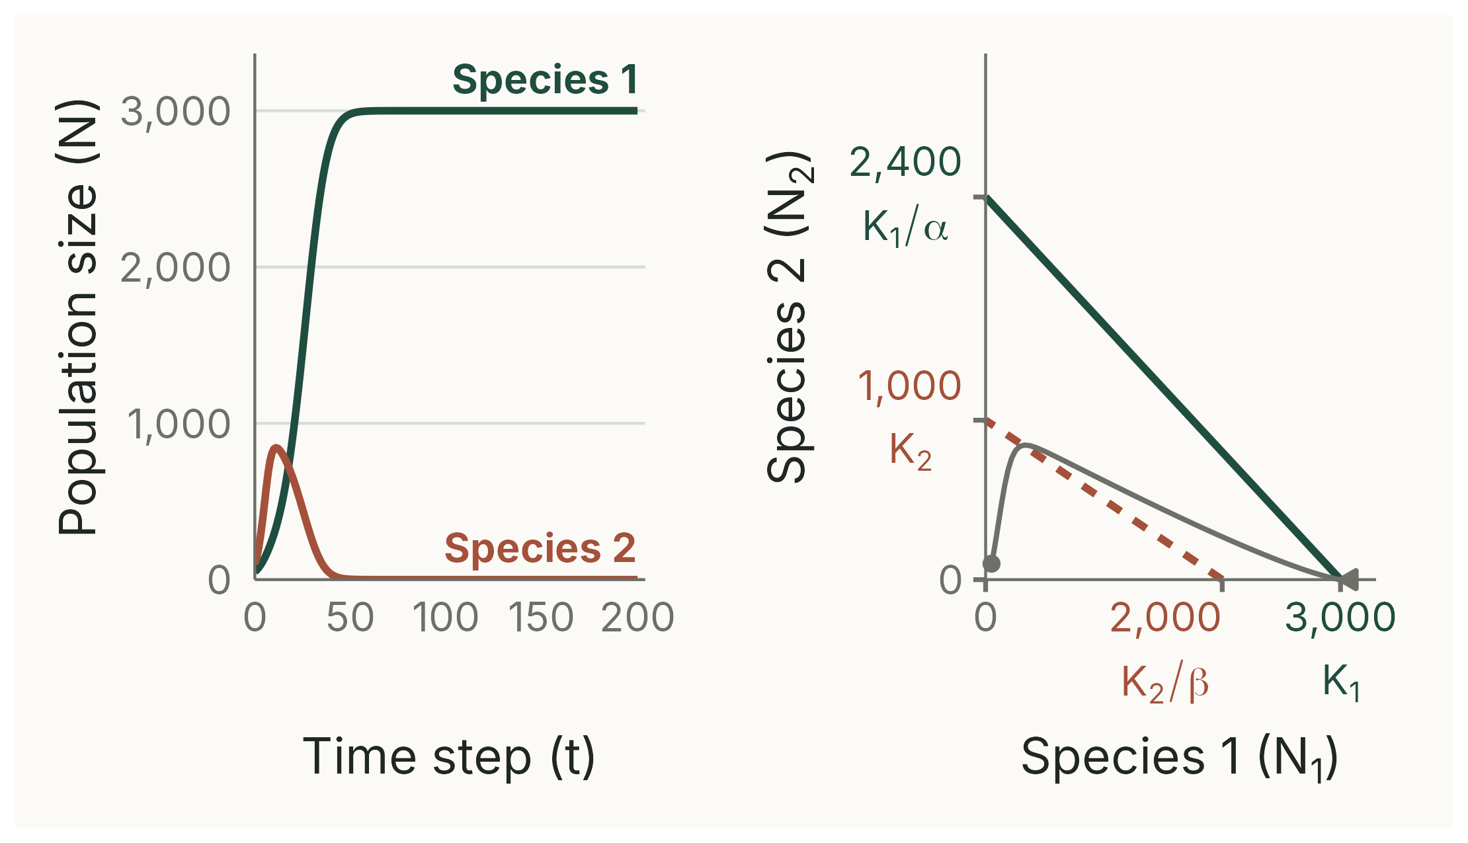
Q1: species 1 excludes species 2
WHY
Species 1 can invade (α = 1.25 < K₁/K₂ = 3); species 2 cannot (β = 0.5 > K₂/K₁ = 0.33). Species 1 wins even though species 2 grows faster, starts larger and α > 1.
Notes:
(3 min) R~1~ = 0.25, K~1~ = 3000, α = 1.25; R~2~ = 0.5, K~2~ = 1000, β = 0.5; start N~1~ = 50, N~2~ = 100. After 50 time steps the sheet shows about (2979, 2.4); by 200, (3000, 0).
Changing R or the starting numbers does not change the outcome.
Ecological meaning: species 1 can keep growing even when species 2 is at its own carrying capacity, but not the other way round.
Deterministic simulation, script 04_answer_q1.R.

Slide 8
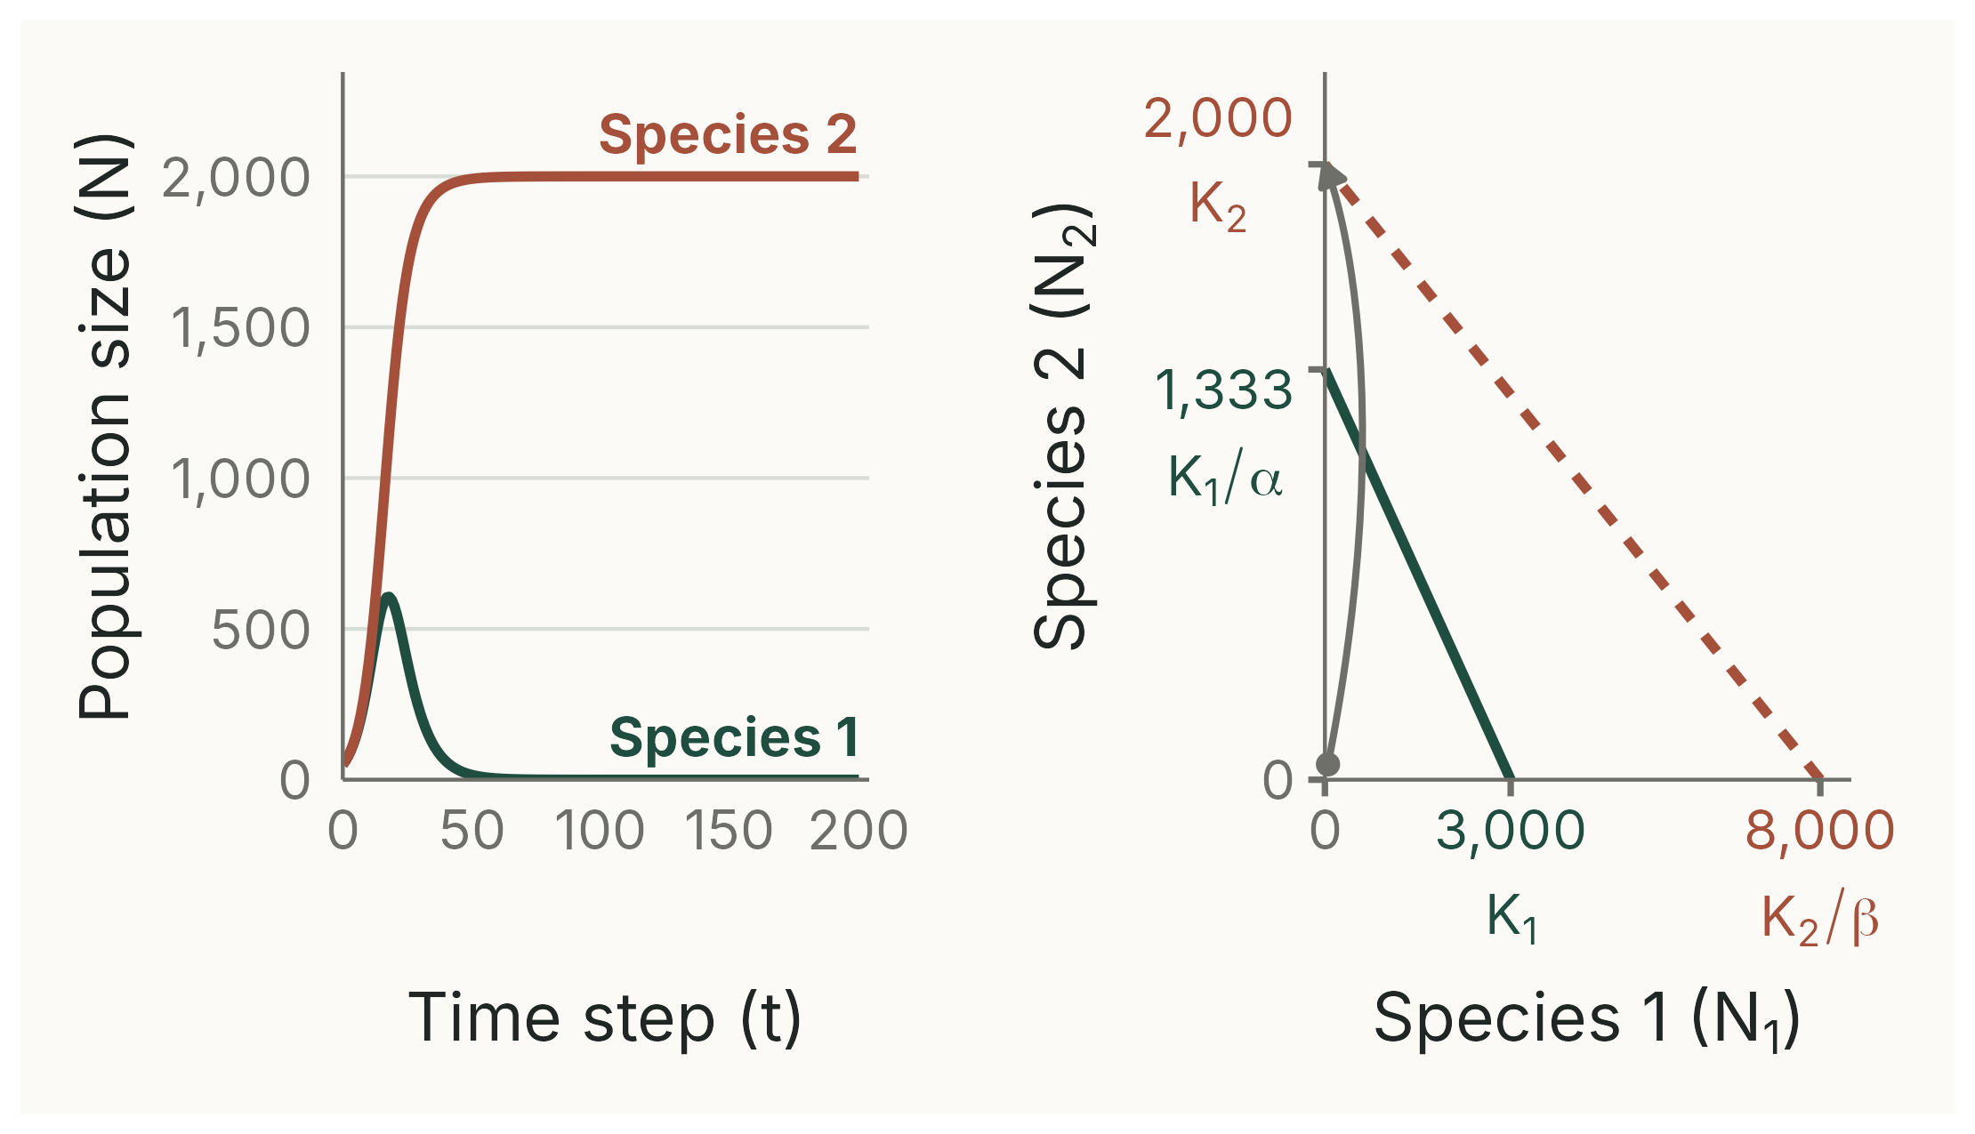
Q2: species 2 excludes species 1
WHY
Species 2 can invade (β = 0.25 < K₂/K₁ = 0.67); species 1 cannot (α = 2.25 > K₁/K₂ = 1.5). Species 2 wins although K₁ > K₂.
Notes:
(2 min) R~1~ = R~2~ = 0.25, K~1~ = 3000, α = 2.25; K~2~ = 2000, β = 0.25; start 50 and 50.
The phase plot's axes are not to the same scale: K~2~/β = 8000 is far out on the N~1~ axis.
Ecological meaning: species 2 hardly notices species 1 (small β), while species 1 is strongly suppressed by species 2 (large α), for example through interference.
Deterministic simulation, script 05_answer_q2.R.

Slide 9
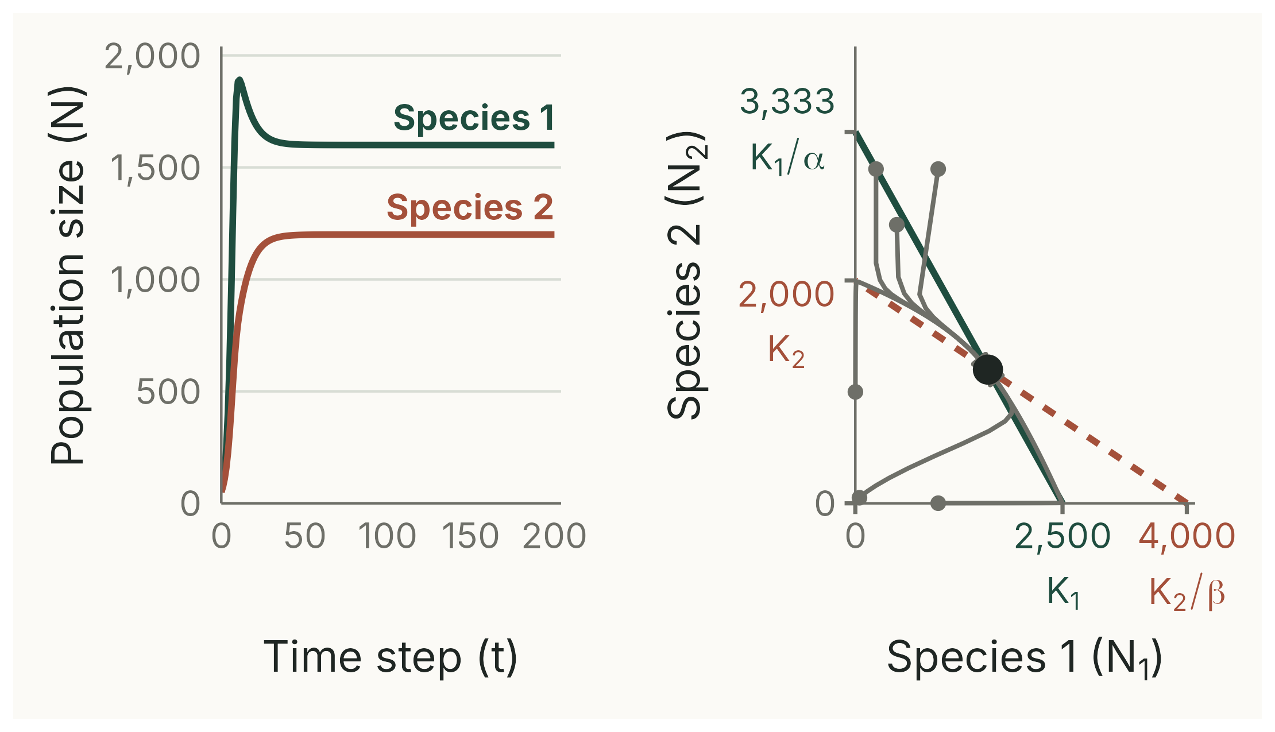
Q3: stable coexistence
WHY
Both can invade (α = 0.75 < 1.25; β = 0.5 < 0.8). From every start the populations return to (1600, 1200).
Notes:
(3 min) R~1~ = 0.75, K~1~ = 2500, α = 0.75; R~2~ = 0.5, K~2~ = 2000, β = 0.5. Time series from (50, 50); the phase plot adds the five other starts from the book: (1000, 1), (1, 1000), (500, 2500), (1000, 3000), (250, 3000).
From (1000, 1) and (1, 1000) it takes more than 50 time steps to settle (at t = 50, (1000, 1) is still at about (1760, 1037)): this is why the sheet needs 200 rows.
Equilibrium: N~1~* = (2500 − 0.75 × 2000)/(1 − 0.375) = 1600; N~2~* = (2000 − 0.5 × 2500)/0.625 = 1200.
Ecological meaning: each species limits itself more than it limits its competitor (in the scaled sense), for example because they partly use different resources.
Deterministic simulation, script 06_answer_q3.R.

Slide 10
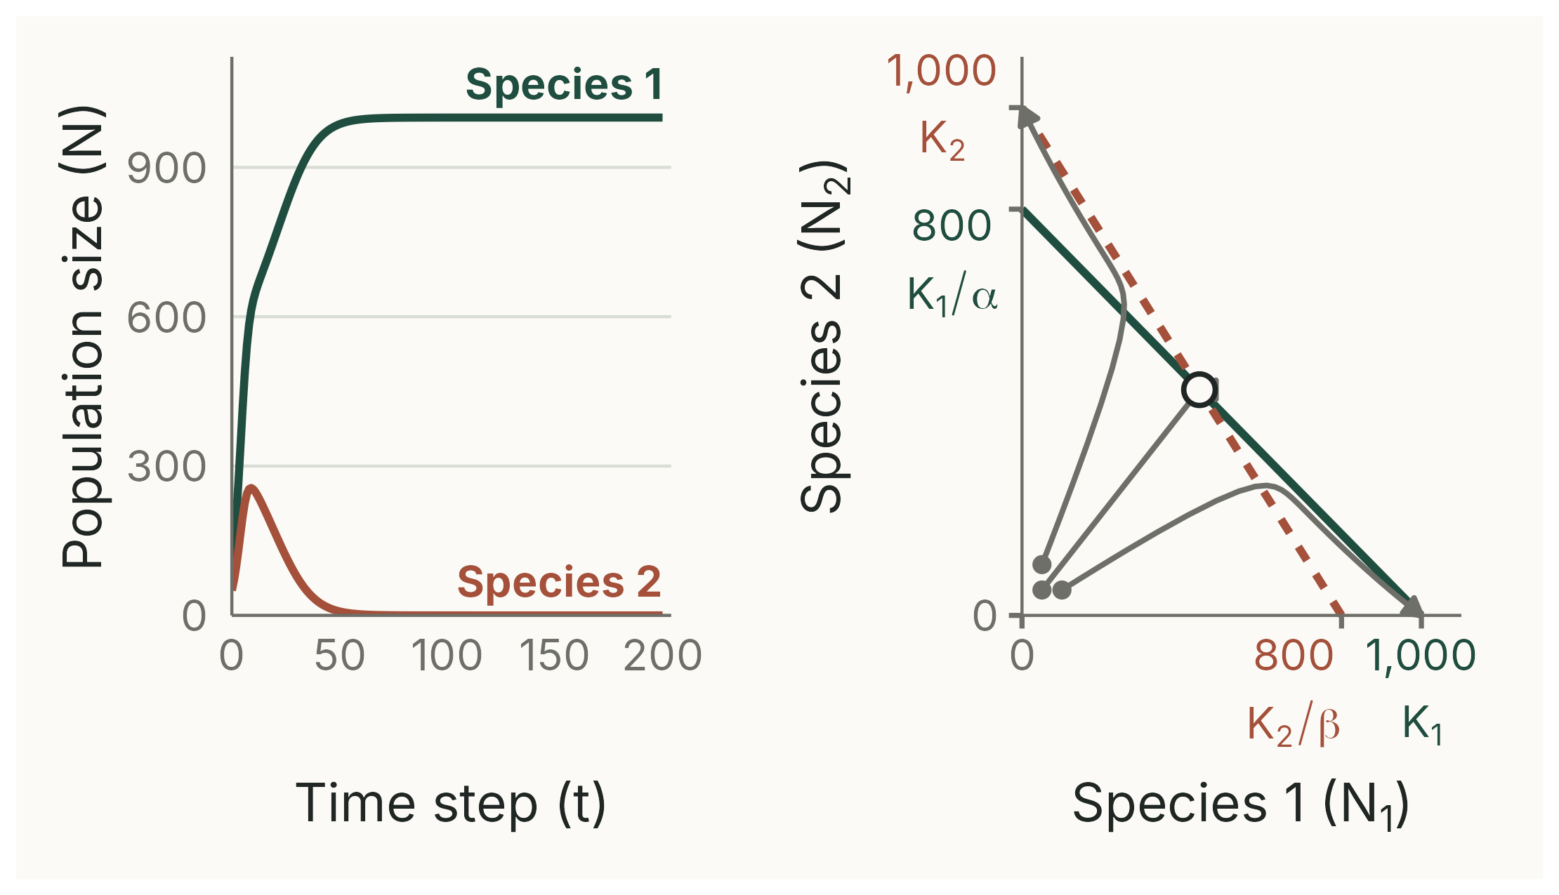
Q4: the start decides
WHY
Neither can invade (α = β = 1.25 > 1). The equilibrium at (444, 444) is unstable: from (100, 50) species 1 wins; from (50, 100) species 2 wins.
Notes:
(3 min) R~1~ = R~2~ = 0.5, K~1~ = K~2~ = 1000, α = β = 1.25. Starting exactly at (50, 50) the populations go to (444, 444) and stay, but only because the model is deterministic: any disturbance tips them off.
Even (445, 444) ends at (1000, 0), but slowly: at t = 50 it is still at about (452, 437); it reaches (1000, 0) after about 150 steps.
Growth rates matter too: from (50, 50) with R~1~ = 0.8 and R~2~ = 0.4, species 1 wins; swap them and species 2 wins.
Ecological meaning: each species affects the other more than itself, for example through interference or mutual predation.
Deterministic simulation, script 07_answer_q4.R.

Slide 11
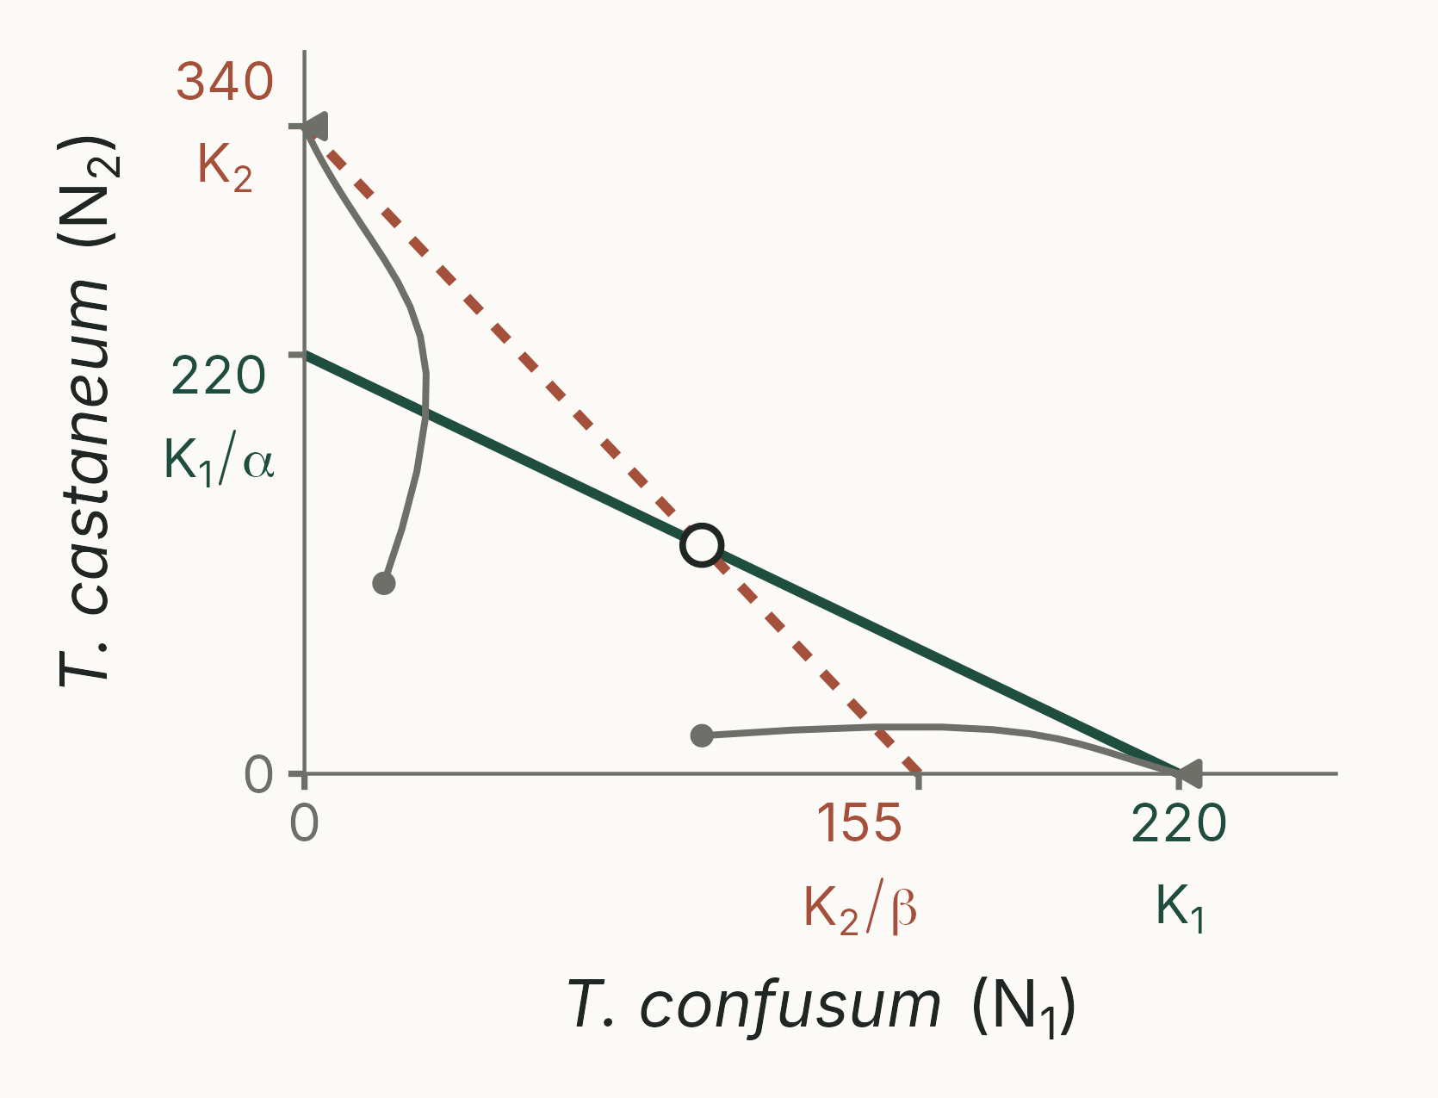
Q5 (optional): flour beetles
Park (1962): Tribolium confusum (K₁ = 220) and T. castaneum (K₂ = 340); α = 1, β = 2.2
Neither can invade, so the start decides
Park found the same, with an 'indeterminate zone' where either could win by chance
Rhizopertha and Oryzaephilus: both can invade, and they coexist at about (233, 412)
Notes:
(2 min) Book Q5. Parameters from Neal (24 °C, 70% relative humidity). The trajectories are a deterministic simulation with R~1~ = R~2~ = 0.5 (illustrative): (100, 20) goes to *T. confusum* at 220, (20, 100) to *T. castaneum* at 340. Unstable equilibrium at (100, 120).
Second pair (Crombie 1945): *Rhizopertha* K~1~ = 330, α = 0.235; *Oryzaephilus* K~2~ = 440, β = 0.12; equilibrium (233, 412). Their larvae feed in different places (inside versus on the grain surface), a niche difference.
Script 10_tribolium.R.

